Slide 1


Covid-19 Hospitals in New York
Coursera IBM Data Science Final Assignment

Slide 2

Covid-19: Optimizing medical supplies
Numerous reports on severe shortages of medical supplies in USA from Covid-19 outbreak
For hospitals which has sufficient masks, PPE suits or ventilators to spare, this study can help the country or state to optimize the medical supplies among themselves
Foursquare will be used in getting the data

Slide 3
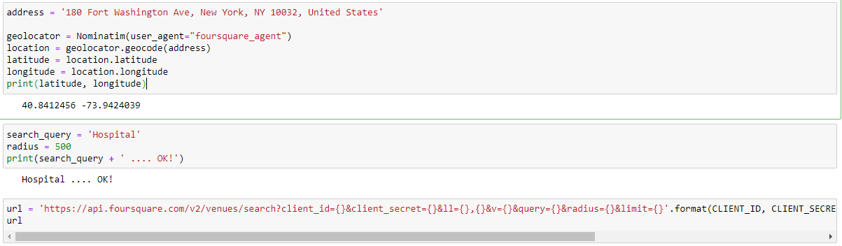
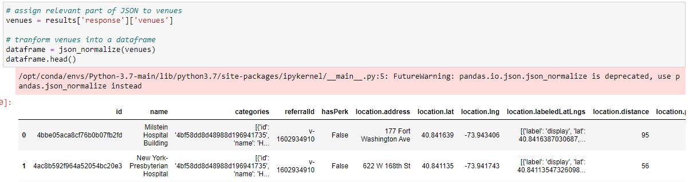
Data Acquisition and Cleaning
Assuming one of the hospitals has sufficient masks, PPE suits or ventilators to spare with address as per below:
We get the preliminary results in json format and put it in pandas dataframe:

Slide 4
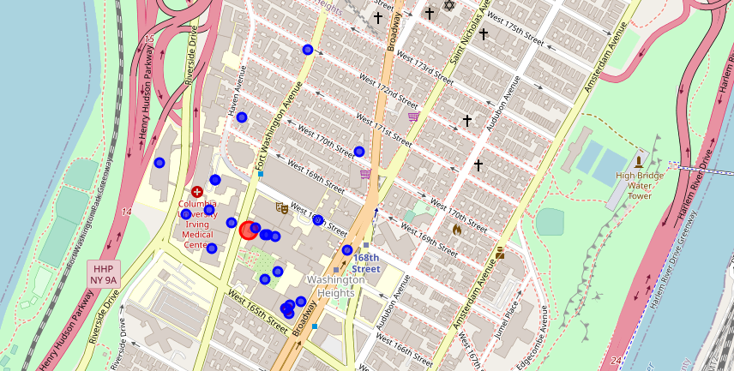
Results
Perform data cleaning to keep relevant information/ columns and put into map
The red circle indicates the hospital we had assumed with the supplies sufficient to help other hospitals in our study.
The blue circles shows which hospital is the nearest and furthest limited to 500 radius around it

Slide 5
Discussion & Conclusion
From the map, there are overlapping blue circles which may be under the same hospital management as we study the names in detail. Hospitals specializing in Orthopedic or Psychiatric are under this same hospital list is less relevant for this study and could be omitted.
To take this study to a higher level we can take further steps by mapping population to check population density of the area and priority can be given to hospitals with higher population around the area.
This preliminary study will allow optimization of constrained resources and effective allocation can be done to ensure more citizens has better chances of getting their medical supplies which will reduce the spread of virus and save their lives.

